Slide 1
Prof A N Mitra Memorial Seminar April 14-15, 2025
Prof Mitra has been a source of inspiration for me all through my life on all three fronts: Physics, Mathematics and spirituality
This inspiration have been in both visible and invisible (Eklavya style) forms
Prof Mitra had liking for the Vedanta Philosophy
Prof Mitra wrote the FOREWORD of my first book on Vedanta Philosophy (1994), which proved to be a source of inspiration for me for my future work in Vedic Science
Even today, after 30 years or so, I am using the same proposed patomic (Philosophical atom-like ) model in giving a scientific flavour to the wisdom described in Upanisads and Srimad Bhagvad-Gita, with reference to a functional human Being. In particular, attempts have been there to understand human behaviour and experiences using some analogies borrowed from physical sciences and theories
To this effect, I wish to quote the concluding paragraph of Prof Mitra’s Article in Current Science, “ Profiles of Scientific Philosophy: Paradigms and Serendipity” (Vol 64, 1993)
“I am dancing with my ego phase,
I am a particle my ego a wave.”
Next, I elaborate the meaning of this phrase through the patomic model

Slide 2
From Atom to Atma: Exploring a Model for Human Consciousness
R. S. Kaushal
Formerly UGC Research Professor, Department of Physics & Astrophysics, University of Delhi, Delhi 110007, and AD-48C, Shalimar Bagh, Delhi-110088, India (E-mail: kaushal.rs@gmail.com)
Contents
1. Introduction 2. Psychoscience as a Bridge between the Spiritual and Behavioral sciences 3. Psychophysics and Patomic Model of a Functional Human Being 4. Consciousness Creates Space, Time and Geometry: Meditation Variable and Psychomechanics 5. Searching A Theory of Human Interactions and Relations: Psychochemistry 6. Patomic Model and the Personality Theory of Carl Jung 7. Tracing a Theory of Subconscious Mind in Patomic Model 8. Concluding Discussion: Future Prospects

Slide 3
Fig.2: A modified version of patomic model
Psychophysics: Patomic Model
Books &Articles: (1990; 1994; 2011; 2015; 2024)
Based on famous Verses from Srimad-Bhagvad-Gita (SMBG), namely Verses 3.42; 7.4
Symbols: Undeniable Essences of Life (EOLs)
WO= worldly objects & stimuli, like physical world, wealth, power and fame
B= biological body
SE = senses of knowledge and action
M= mind; I= intellect; E= ego (self-sense)
(recall ‘antahcasutaya’, where ‘citta’ → dressing rules)
SO = inner-most existence (soul)
b = Being or Jiva or life-principle
Three existences: G={WO, B, SE}; M ={M,I,E}; C ={SO}
b= seed of all essences of life:{WO, B, SE, M, I, E , SO} and performs both upward (rare) & downward (frequent) transitions in the space of meditation

Slide 4
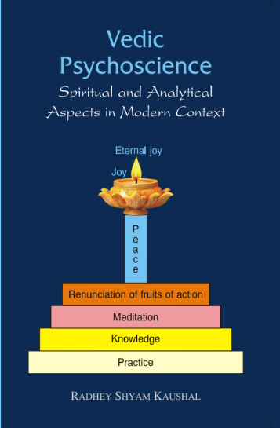

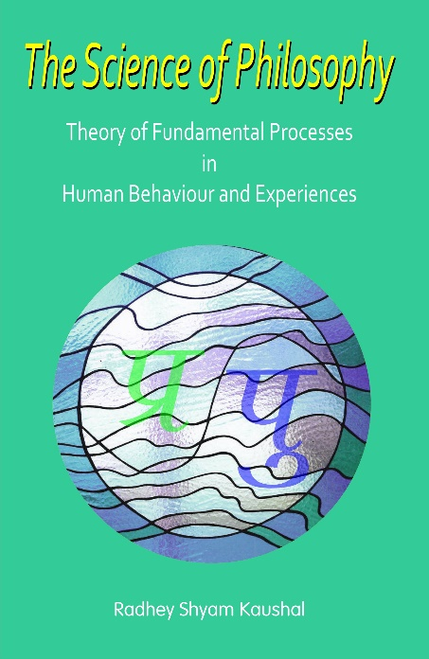
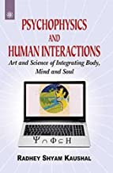
HISTORY OF PATOMIC MODEL
Indian Book Center DK Print World New Age Books Published by DK Print World (1994) (2011) (Motilal Banarasi Das) (2015) (2024)

